Slide 1

INVENTOR VS PATENT ATTORNEY: CREATIVITY

Slide 2
INVENTOR VS PATENT ATTORNEY: CREATIVITY

Slide 3
Creativity
Noun 1. Creativity : the ability to create
Synonyms : creative thinking, creativeness

Slide 4
Creativity of inventor: basis
Competence in your speciality
Broad outlook
Unconventional approach
Concentration on a problem

Slide 6
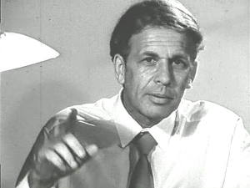
Genrich Altshuller
Developer of TRIZ
TRIZ is a problem solving which accelerates the project team’s ability to solve these problems creatively. “TRIZ” is the (Russian) acronym for the “Theory of Inventive Problem Solving.” G.S. Altshuller and his colleagues in the former U.S.S.R. developed the method between 1946 and 1985. TRIZ is an international science of creativity that relies on the study of the patterns of problems and solutions, not on the spontaneous and intuitive creativity of individuals or groups. More than three million patents have been analyzed to discover the patterns that predict breakthrough solutions to problems.

Slide 7
Creativity of patent attorney: basis
Broad outlook
Competence in law
Language skills
Communication and psychological skills
Ability to bear in mind various conditions
Take a stand

Slide 8
Stages at which creativity is required
Communication with the inventor
Analysis of the object and defining protectable matter
Drafting claims

Slide 9
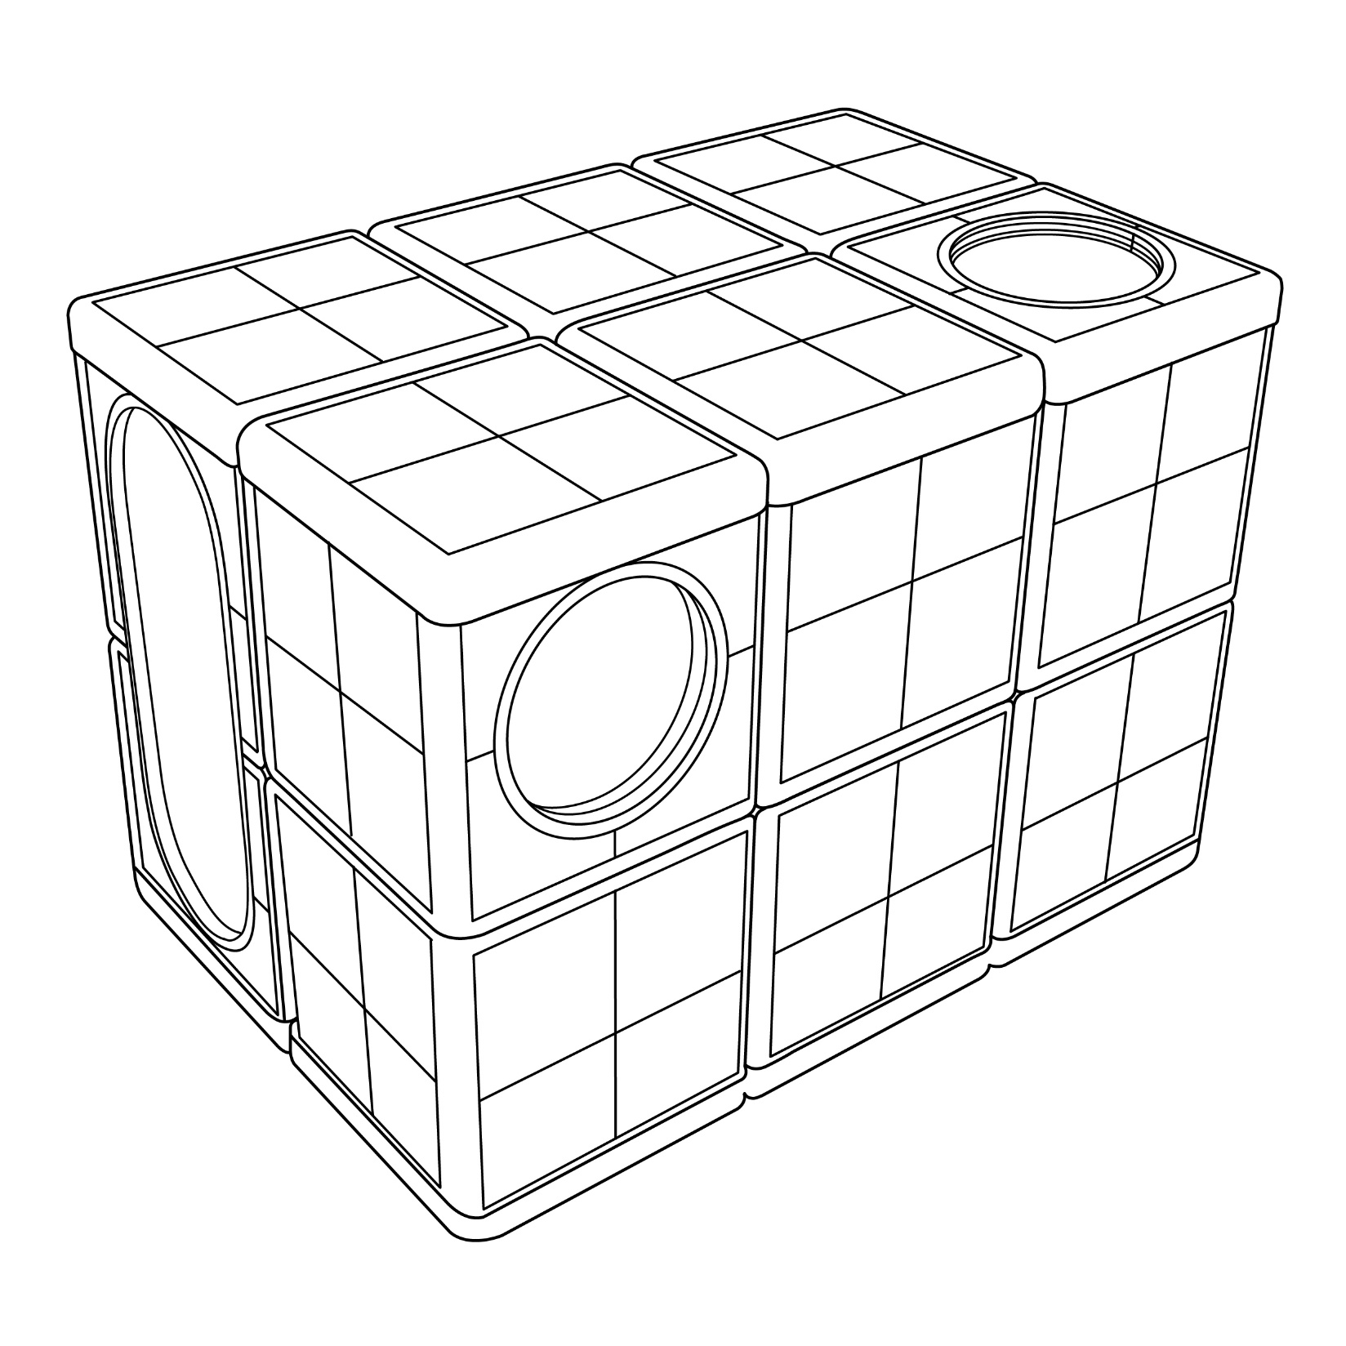

Slide 10
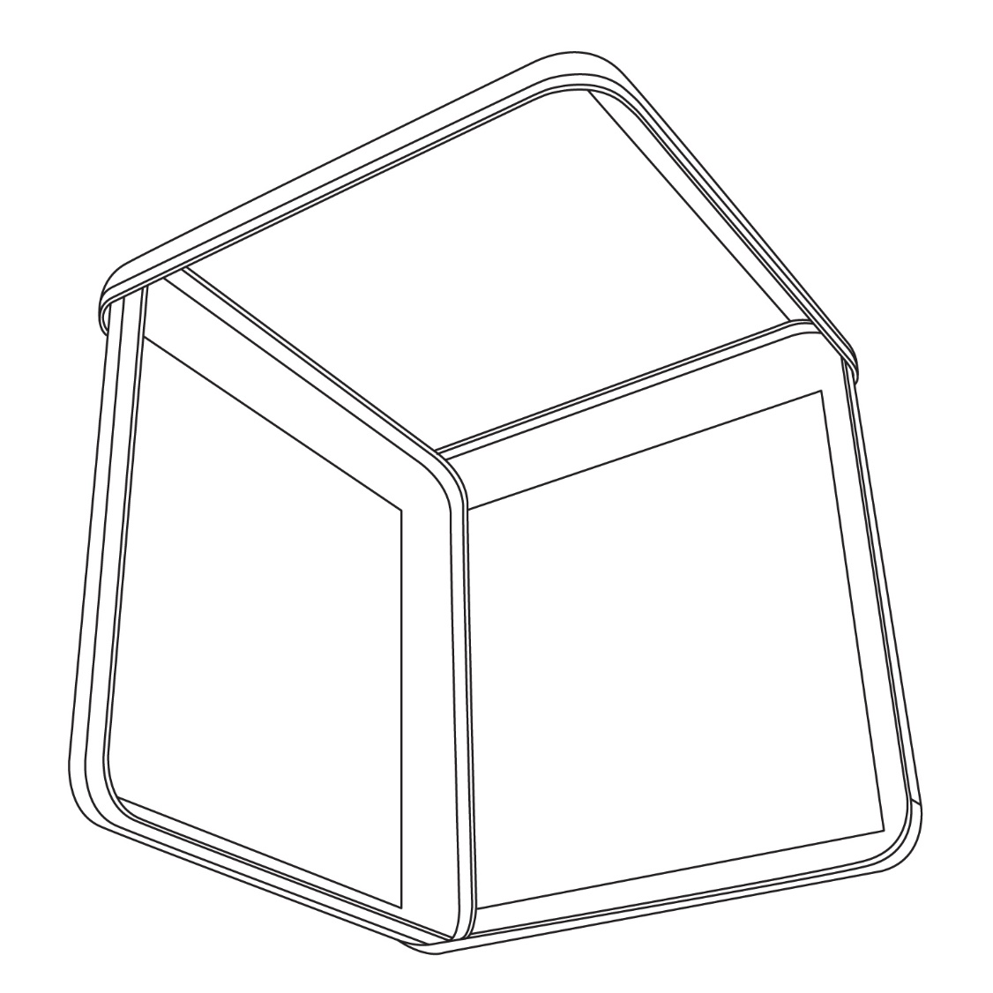

Slide 11
1. A set of flanged panels, wherein each of the panels has a side matable with a side of another panel,
characterized in that,
the mating side of one panel is shorter than a mating side of the other panel, so that the panel having the shorter mating side can be tilted at an angle with respect to the panel having the longer mating side and fitted between the flanges thereof.

Slide 12
6. A collapsible modular building structure comprising walls and a roof, the walls and the roof further comprising flanged panels, wherein each of the panels has sides matable with sides of adjacent panels,
characterized in that,
the flanged panels defining an interface between the roof and a wall are configured and mated with each other in such a way that mating side of one mating panel is shorter than mating side of the other mating panel, so that the panel having the shorter mating side is fitted between the flanges of the panel having the longer mating side.

Slide 13
Thank You

