Slide 1
13th Annual International Seminar on Intellectual Property Rights
Smart Solutions to Global Challenges
Indian Designs Law
Yogesh V Bajaj
Assistant Controller of Patents and Designs.

Slide 2
Designs Act, 2000
Designs Rules, 2001 vis-a-vis
DESIGN APPLICATION
EXAMINATION
&
Related Procedures

Slide 3
RECAP: Intellectual Property Rights
Patent
An invention on remote control mechanism can be protected by Patent Law. Patent right is valid for 20 years from the date of filing.
Trade Mark
Trademark “SONY” can be protected by Trademark Law.
Copyright
User manual is protected by Copyright Law
SONY
Designs
A design of TV set can be protected by Design Law. Design right is valid for 15 years from the date of its registration.

Slide 4
Importance of Design
Makes a product look attractive & appealing to customer & may even be its Unique Selling Point.
Protect the appearance of your products against copying and infringement
Adds value to product.
Fair return on investment.
Build a business asset.
Fair Competition.

Slide 5
WHY REGISTRATION OF DESIGN IS REQUIRED?
To protect any new / original design applied to any article which is a creation of human intellect by way of registration.
To prevent the imitation/commercial exploitation of innovator’s design without prior consent of the proprietor/originator.
To obtain reward by commercially exploiting the design as well as assigning / licensing the same to other parties.

Slide 6
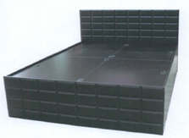






DESIGN IN EVERYDAY LIFE

Slide 7





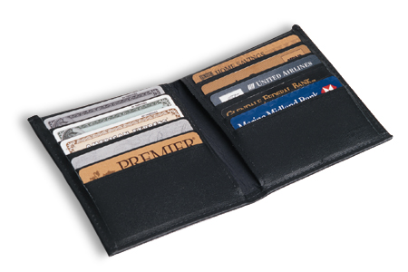



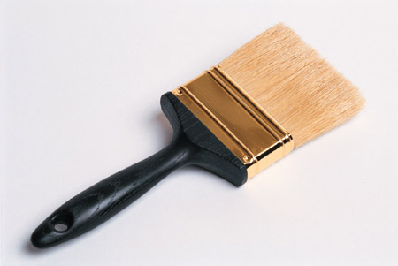






Consumer Products

Slide 8




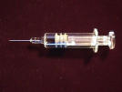







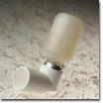




Pharmaceutical Product

Slide 9














Textile & Jewellery

Slide 10
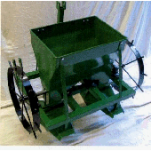




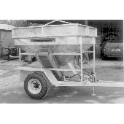
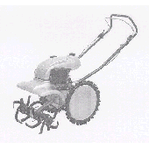
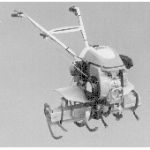
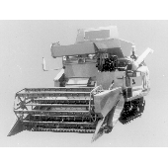
FARM MACHINARY

Slide 11
Trend of Filing & Registration of Design Applications
Year | Filed | Registered
2004-05 | 4017 | 3728
2005-06 | 4949 | 4175
2006-07 | 5521 | 4250
2007-08 | 6402 | 4928
2008-09 | 6557 | 4772
2009-10 | 6092 | 6025
2010-11 | 7589 | 9206
2011-12 | 8373 | 6590
2012-13 | 8337 | 7252
2013-14 | 8533 | 7178
2014-15 | 9382 | 7171
2015-16 | 11108 | 7904

Slide 12
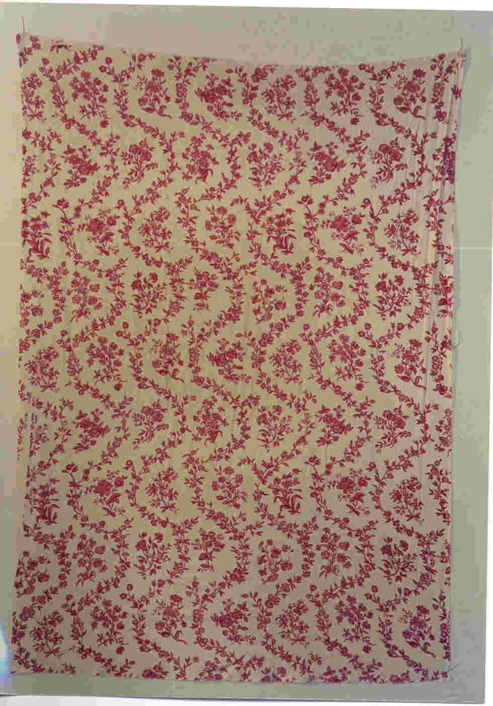

  DESIGNS
  A category of IPR which focuses on the aesthetic feature of an article derived from its visual appearance.
  Relevant aspects are :
  shape,
  configuration,
  surface pattern, the
  colour or line or a combination thereof
  as applied to an article which produces an aesthetic impression on the sense of sight.

Slide 13
“When companies are competing at equal price
&
functionality
Design is the only differential
that matters”
– Mark Dziersk, quoted in TIME Magazine

Slide 14
Design Power
Actual Cost
Cost Influence
30%
5%
“While Design typically represents the smallest actual cost element in products, it powers the largest cost influence.”
Overhead
5%
20%
15%
Labour
70%
50%
Material
Mikel Harry, Ph. D. and Richard Schraeder Doubleday, New York, 2000, Page-153
5%
Design

Slide 15
Designs: Legislations
1872: The Patents & Designs Protection Act
1883: The Inventions & Design Act
1911 : The Indian Patents & Designs Act 1911
( 2 of 1911)
2000: The Designs Act,2000 (No. 16 of 2000)
The Designs Rules ,2001
The Designs ( Amendment) Rules 2008
The Designs ( Amendment) Rules 2014

Slide 16
THE DESIGNS ACT, 2000
[ No. 16 of 2000]
An Act to consolidate and amend the law relating to protection of designs
Repealed The Designs Act ,1911
Published in the Gazette of India
( Extraordinary Part II – Section I)
dated 12.05.2000

Slide 17
The Design Rules
Sub section (1) of Section 47 of The Designs Act 2000 —“ the Central Government may, by notification in the Official Gazette , make rules for carrying out the provisions of this Act”
The Design Rules ,2001 w.e.f.11.05.2001
The Design ( Amendment) Rules, 2008
w.e.f. 23.06.2008
The Design ( Amendment) Rules, 2014
w.e.f. 30.12.2014

Slide 18
Designs Act, 2000 &
Designs Rules (2001)
(Amendment Rules, 2008 & 2014)
48 Sections
48 Rules
5 Schedules :
Schedule I : Fees (29 entries)
Schedule II : List of Forms (24 entries)
Schedule III : Classification of Goods
Schedule IV : Costs allowable in proceedings before Controller
Schedule V : Certificate of Registration

Slide 19
Some Definitions under the Designs Act, 2000
ARTICLE [Section 2(a)]
means
any article of manufacture and
any substance,
(which could be)
artificial, or partly artificial and partly natural and includes any part of an article capable of being made and sold separately.

Slide 20

‘Set of Articles’ [Rule 2(e)]
‘Set’ means a number of articles of the same general character ordinarily sold together or intended to be used together; all bearing the same design, with or without modification not sufficient to alter the character or substantially to effect the identity thereof.

Slide 21
Provisions of Copyright Act as applied to a Design
[Section 15 of The Copyright Act 1957 ]
A creator of a design shall keep in mind the following provisions of the Copyright Act, 1957:
a. Copyright shall not subsist under the Copyright Act in any design which is registered under the Designs Act.
b. Copyright in any design, which is capable is being registered but which has not been so registered shall cease as soon as any article to which the design has been applied has been reproduced more than fifty times by an industrial process, by the owner of the copyright, or with his license, by any other person.

Slide 22
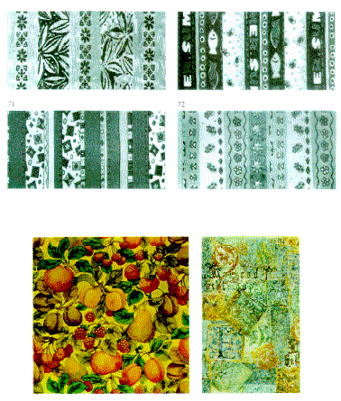
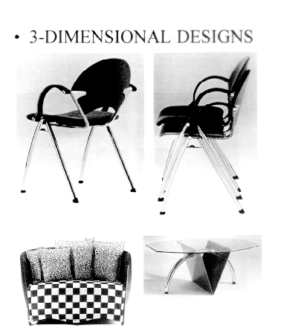
CRITERIA FOR DESIGN REGISTRATION
Should satisfy Section 2(a)
Should satisfy Section 2(d)
Should be ORIGINAL (Section 2(g)]
Should satisfy Section 4
Should satisfy Section 5(1)
Should not prejudice the Security of India under Section 46

Slide 23
CLASSIFICATION OF GOODS [Rule 10]
For the purposes of registration, articles shall be classified as specified in the Third Schedule
If any doubt arises, it shall be determined by the Controller
    32 CLASSES (31 Main classes and 1 Misc. Class as 99) based on LOCARNO SYSTEM
    Classes are further divided into Sub-Classes
    Classification is based on nature & function of the Article
    When a Design Application is for an article with multiple utilities, the application may be made in any one or more of the utilities. For instance, in case of a design of pen cum torch, the applicant is at liberty to apply in the class relating to pen, torch, pen-torch, or file two applications in different classes for better protection.

Slide 24
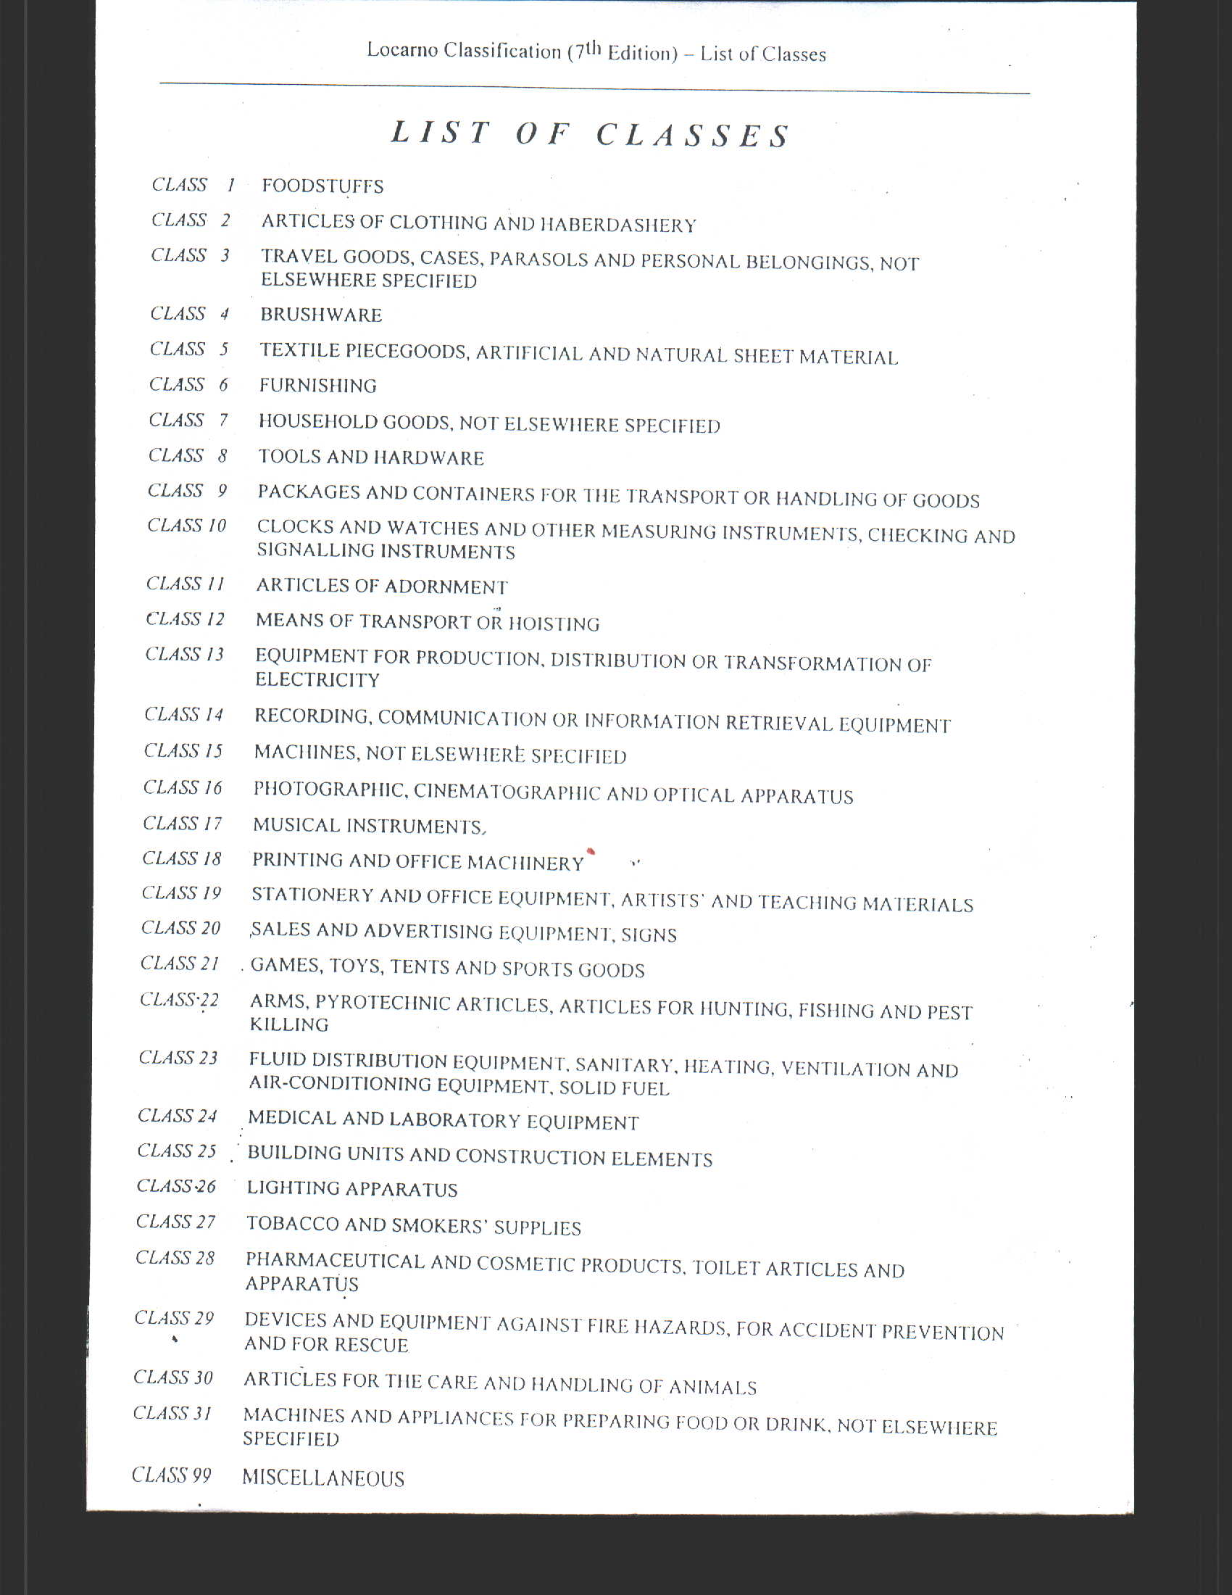
When a Design Application is for an article with multiple utilities, the application may be made with depiction of an article in any one or more of the utilities. For instance, in case of a design of pen cum torch, the applicant is at liberty to apply in the class relating to pen, torch, pen-torch, or file two applications in different classes for better protection.

Slide 25
DESIGN APPLICATION EXAMINATION
&
REGISTRATION PROCEDURE

Slide 26
FILING OF DESIGN APPLICATION
Section 5, 44 & Rule 11
ANY PERSON
Person Includes:
1. Natural Person
2. Other Than Natural Person
2.1 Small Entity

Slide 27
Jurisdiction for Filing Design Application
(Rule 3)
Receiving/Examination/ Registration/ Post-Registration
KOLKATA
Delhi
Mumbai
Chennai
Receiving Office
Receiving Office
Receiving Office

Slide 28
Requirements for Application
1. Application Fees (Rs 1000/2000/4000/-)
(Differential Fee according to legal status of applicant)
2. Application Form-1 with
applicants full name,
nationality, legal status,
address, address for service in India
class no, name of the article
Priority data (if any)
Prior registration data (if any)
Signature & Date
3. Four sets of Representation depicting various views of article.
4. Power of attorney (if required) : Form-21 (Section – 43)
5. Priority document (for reciprocity application)
6. Assignment document (if any)
7. Form 24 (if applicant is small entity)
7.1. Documentary evidence w,r,t F-24 (For Indian Small Entity)
7.2. Affidavit w,r,t F-24 (For Foreign Small Entity)

Slide 29
REPRESENTATION (Rule 14, 12, 11)
Four copies of the representation
A representation may contain more than one page.
Representation shall be exactly similar drawings, photographs, tracings including computer graphics or specimens of the design
Representation shall be prepared on white A4 size paper (210 mm X 296.9 mm) of durable quality, but not on card board, and only on one side of the paper.
The figure(s) shall be placed in an upright position on the sheet. Each figure shall be designated clearly (e.g. perspective view, front view, side view).
In case, name or representation of living persons appear on a design, consent of such persons may be submitted along with the application
In case of a deceased person, the consent of legal representative may be submitted.

Slide 30
REPRESENTATION….contd
A statement of novelty and disclaimer (if any) in respect of mechanical action, trademark, word, letter, numerals should be endorsed on each representation sheet
Representation, which consists of a repeating surface pattern, shall show the complete pattern, and a sufficient portion of the repeating pattern in length and width, and shall not be less than 15.00 centimeters by 10.00 centimeters in size
The name of applicant shall be mentioned in left hand top corner of the representation sheet.
Total number of sheets and sheet number shall be mentioned in the right hand top corner
The representation sheet shall be signed and dated by the applicant/agent.
No descriptive matter or matter denoting the components by reference letters/numerals shall be included.
No partial/sectional views shall be incorporated in the representation sheet.

Slide 31
REPRESENTATION….contd
Dimensions or engineering symbols etc. shall not be used in the representation sheet.
Trade Marks, words, letters or numerals should be disclaimed
No extraneous matter or background shall appear in the representation sheet.
A background is considered neutral as long as the design is clearly visible in it
When colour combination is the essence of a design as applied to an article, the same shall be clearly depicted in the representation.
Colouring may be used, on a black and white drawing, to highlight only those features of the design for which protection is sought. In such cases, it shall be clearly indicated in the novelty statement that the claim is restricted only to the portions depicted by colouring and the colours so given are not part of the design.

Slide 32
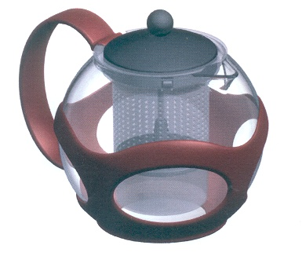
Specimen of Representation Sheet
Name…….
Total sheet….
Sheet No…..
Perspective View
Perspective View
The novelty resides in the shape & configuration of the ‘TEA POT' as illustrated.
No claim is made by virtue of this registration in respect of any mechanical or other action of any mechanism whatever or in respect of any mode or principle of construction of the Article.
No claim is made by virtue of this registration to any right to the exclusive use of the words, letters, numbers, or trade marks appearing in the representation.
Dated: Signature of the applicant/agent
(Name of the Signatory)

Slide 33
FLOW CHART OF DESIGN APPLICATION UPTO
REGISTRATION
Numbering & Dating
Of Application &
Formalities check
Substantive
Examination of
Application along with search
Filing of
Application
Abandoned due to default or neglect of applicant
Noncompliance of
Objection(s)
Communication of
Objection(s)
Noncompliance of
Objection(s)
Refusal
Hearing if Objection(s)
Is contested
Compliance of
Objection(s)
Re-Examination
Appeal to
High Court
Waiving/Removal
Of objection's)
Acceptance
In case of allowances
Of Appeal
Publication in the
Official Journal
Issue of
Certificate of Registration

Slide 34
EXAMINATION PROCEDURE (Section 5)
The application for registration of a design is referred by the Controller to an Examiner for conducting examination as to:
Whether the application and the documents satisfy the formal requirements
Whether such design as applied is capable of being registered under the provisions of the Designs Act and Rules.

Slide 35
Formal Examination
The Examiner reports on following issues:-
whether the application is in prescribed format;
whether the prescribed fee has been paid;
whether bibliographic data are mentioned appropriately;
whether priority data mentioned appropriately along with submission of priority document
whether assignment document, if any submitted
whether address for service is given;
whether declaration of proprietorship is given;
whether representations are in prescribed manner as prescribed under Rule 14
Power of authority, if applicable
Form-24 and corresponding documents, if applicable
Any deficiency, reported to Controller

Slide 36
Substantive Examination
Examiner has to check whether the design is registrable with regard to:
Section 2(a)
Section 2(d)
Section 4(a)
Section 4(b)
Section 4(c)
Section 4(d)
Section 5(1)
Section 6
Section 16
Section 21
Section 46
Rule 10 (Classification)
Rule 12 (Novelty St.)
Rule 14 (Representation)
Rule 15 (Reciprocity)
Applicant may be asked by Controller to submit the specimen of the article to ascertain the exact nature of the article (Rule 13)

Slide 37
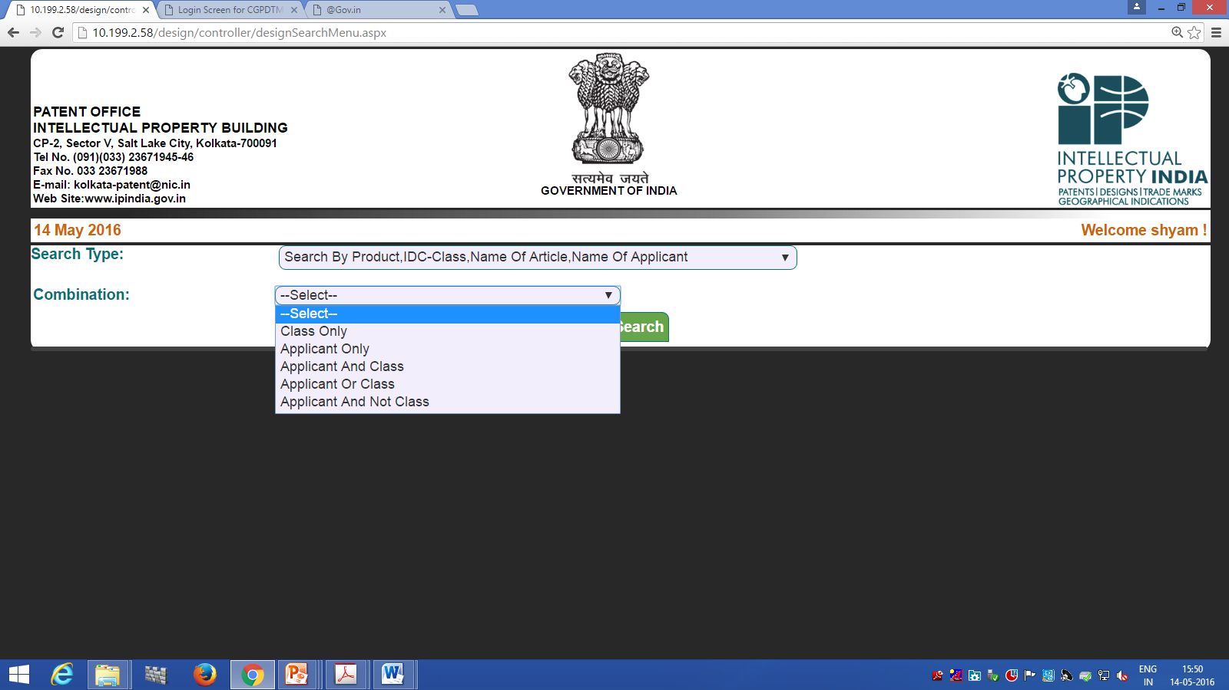

Slide 38
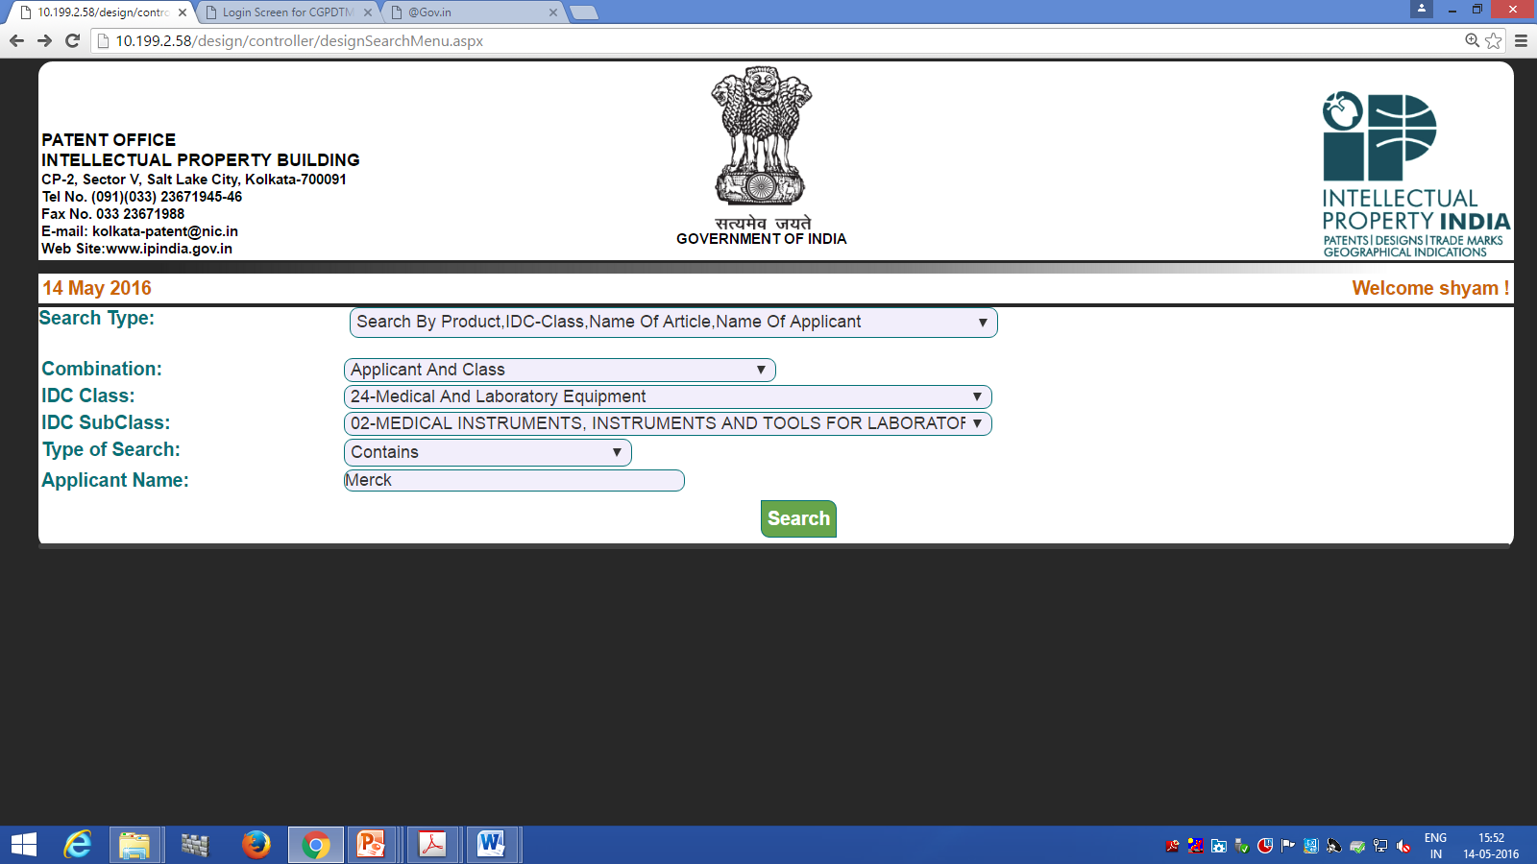

Slide 39
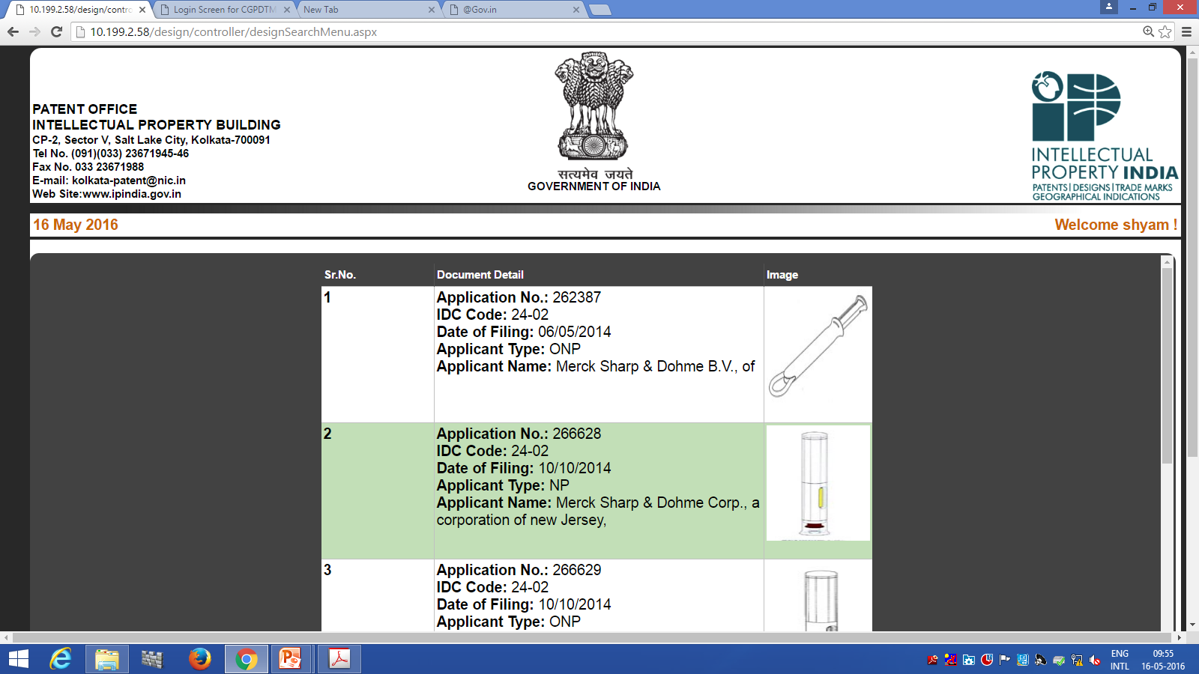

Slide 40
NON-REGSTRABLE DESIGNS
Section 4 (d) – Scandalous / Obscene
Section 5 (1) – Contrary to Public Order or Morality
Section 46 – Security of India
Misc:
Logo, Symbols, Signs, TM,
Mere mechanical contrivance
Parts of articles not manufactured and sold separately
Mere change in size
Flags, emblems, signs of any country
Layout designs integrated circuits
maps, building plan, buildings, medals, interior designs
Sculpture, paintings, drawings

Slide 41
Security of India (Section 46)
Any application for design which is prejudicial to the security of India is not registrable and is not published.
Security of India in the context relates to any article used for war or applied directly or indirectly for the purposes of military establishment or for the purposes of war or other emergency in international relations
Examiner reports to Controller (w r t Sec. 46) who then refers the application to DRDO for direction
On receipt of a view favourable to the applicant, the application proceeds further.

Slide 42
Consideration of Examiners Report by Controller [Section 5(1), Rule 18]
Upon consideration of the report, if the Controller is of the opinion that there are objection(s) adverse to the applicant, a statement of objections shall be communicated to the applicant by the Controller.
Reply of applicant again examined by the Examiner and forwarded to Controller
Upon consideration of the report on the applicant’s reply, if the Controller is of opinion that the requirements of Act and Rules have not been met, the fact shall be communicated to the applicant clearly mentioning that the application is liable to be refused for reasons to be detailed and fixing a date for hearing.

Slide 43
Consideration of Examiners Report …….contd
If the applicant fails to appear for the hearing without any request for adjournment, the application shall be refused giving a reasoned order.
If written submissions are filed, while the opportunity to be heard is not availed by the applicant, no further opportunity to be heard may be provided and the matter shall be decided in light of the written submissions.
If the applicant complies with all the requirements laid down under the Act and Rules, communicated in the form of statement of objections, the application shall be registered forthwith.

Slide 44
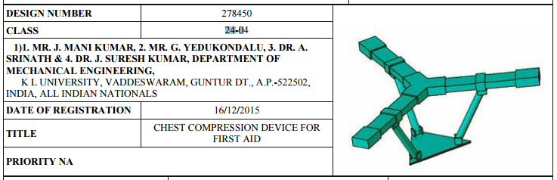
Notification [Section 7, Rule 22]
Publication of the registered design in Patent Office Journal after registration of the design, thereafter it is ready for public inspection-u/s 7
u/r 22 Particulars of the registered design to be published,
One or more best views of representation will be published

Slide 45
IMPORTANT TIMELINES
1) Reciprocity application should be filed within 6 months of priority date
2) Application has to be disposed within 6 months of date of Filing
2.1) The 6 months can be extended upto further 3 months (i.e, 9 months total)
3) If not submitted during filing, Priority documents should be submitted within 3 months of Filing
4) Term of Design (Initially for 10 years from the date of filing or the priority date)
4.1) Extendable by another 5 years
5) Request for renewal to be filed within 10 years
6. Request for restoration of lapsed designs to be filed within 1 year of lapse
7. Request for assignment/transfer to be filed within 6 months from the date of execution of such instruments (extendable by another 6 months with petition)

Slide 46
Piracy of Registered Design [Section 22]
Unlawful Use, Sale, Imitation, Import, Publish of any article belonging to the class in which design has been registered shall be liable for Punishable offence
Recovery of Damage for every contravention is not exceeding Rs. 25,000/- (contract debt)
Total recoverable for any one design shall not exceed Rs. 50,000/-
Relief on the suit or any other proceedings shall be in any Court not below the Court of District Judge

Slide 47


