Slide 1
Intellectual Property rights A key to succesful business strategy IP rights and markets (a case study) Lars Hoppe VKK Patentanwälte www.vkkpatent.com
Notes:
Titel vorlesen
Focus on practical aspects of RCDs
Dont want to bother you with filing details,
Question about procedure at the end of course

Slide 2
Really Important Facts about 30 minutes:
You will:
rotate ~ 800 km
move ~ 50.000 km around the sun
move ~ 400.000 km around our galaxy
The sun will:
send 1.000.000.000 MWh
On earth:
~ 4.700 children will be born
~ 3.800 cars will be produced
India will:
Obtain ~1.600.000 USD GDP
VKK Patentanwälte 2019

Slide 3
Content
Introduction
Case studies
Summary
VKK Patentanwälte 2019

Slide 4
1. Introduction
IP-rights:
impede the exploitation of own technological advances by third parties
Impede the exploitation of companie´s assets
DEFENSIVE USE
VKK Patentanwälte 2019

Slide 5
1. Introduction
IP-rights:
are a companies property
may be owned, transferred and developed
and commercialized to gain return on investment!
VKK Patentanwälte 2019

Slide 6
1. Introduction
IP-rights:
Commercialisation in form of licence:
Trademarks: rather uncommon (except for franchise companies)
Patents: somewhat more frequent
VKK Patentanwälte 2019

Slide 7
1. Introduction
IP-rights:
Commercialisation by own use:
Trademarks: extensive
Patents: extensive
VKK Patentanwälte 2019

Slide 8
1. Introduction
IP-rights:
Commercialisation by own use:
Is it possible to custom-made IP-rights in order to better commercialize them?
product protectable at all and by what IP-right?
Product uses ist potential?
VKK Patentanwälte 2019

Slide 9
1. Introduction
b2b
consumer
Machine tools
!
Roller mills
ships
Destillation column
Reaction vessels
VKK Patentanwälte 2019

Slide 10
1. Introduction
technical
Life style
Air conditioning
food
Clothing
car
refrigerator
kitchen aid
Consumer
electronics
VKK Patentanwälte 2019

Slide 11
2. Case studies - food
Peter KG, founded 1827; Private brewery
1990 turnover diminished, insolvency ahead;
Rescued by product development / switch of products:
Non-alcoholic drinks (limonades, juices)
VKK Patentanwälte 2019

Slide 12
2. Case studies - food
Product development :
goal: natural product, less sugar, different to existing lemonades;
Problem: fermentation of sugar leads to CH₃CH₂OH!
VKK Patentanwälte 2019

Slide 13
2. Case studies - food
Product development :
Invention: Fermentation of sugar to gluconic acid by glucose oxidase taken from bee´s saliva!
where to obtain?
duration 8 years
VKK Patentanwälte 2019

Slide 14
2. Case studies - food
IP-Right?
Primarily: Patent (Product+method)
trademark (product name)
Secundarily: Design (label, bottle)
VKK Patentanwälte 2019

Slide 15
2. Case studies - food
24.02.1994
24.02.1995
06.07.1995
28.10.1998
DE 44 06 087 C1
grant: 44 mon
WO 95/22911
AT, CH, DE, ES, FR, GB, IT, LI, NL
EP 0 748 168
JP, CA
VKK Patentanwälte 2019

Slide 16
2. Case studies - food
EP 0 748 168
VKK Patentanwälte 2019

Slide 17
2. Case studies - food
Trademark
Distinctive character (by law)
Intuitive (Marketing)
Positive associations (Marketing)
Speaking for itself (Marketing)
Alcohol free, brewing, beer, lemonade, bees, sugar, bio, gluconates, …
VKK Patentanwälte 2019

Slide 18
2. Case studies - food
VKK Patentanwälte 2019

Slide 19
2. Case studies - food
Bionade
DE | 31.03.1994 | 21.12.2007
EU | 01.04.1996 | 10.10.2006
IR | 23.08.1995 | 29.08.2007
 | BA, BG, BY, CH, CN, CZ, DZ, EG, HU, IR, KP, MA, MK, PL, RO, RU, SI, SK, UA, VN , AU, BH, JP, NO, SG, TR, US, SG, US | AU, BH, BY, CH, CN, CY, HR, IR, JP, KR, MA, ME, MK, NO, RU, SG, SY, TR, UA, US, SG, US
VKK Patentanwälte 2019

Slide 20
2. Case studies - food
DE 407 03 478.1
AT: 03.07.2007
VKK Patentanwälte 2019

Slide 21
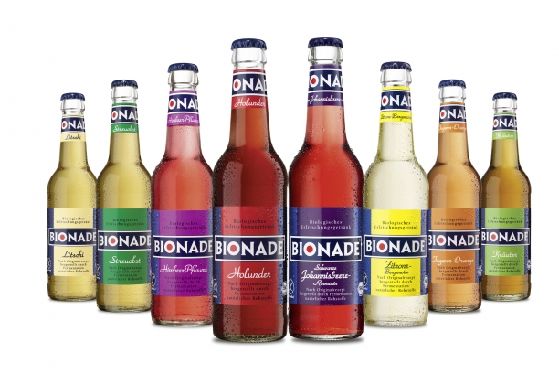
2. Case studies - food
VKK Patentanwälte 2019

Slide 22
2. Case studies - food
Firma | Employees | Annual 2007 | Turnover 2002
Bionade International GmbH | 7 | 3 Mio bot. | -
Bionade GmbH | 57 | 200 Mio bot. | 2 Mio. bot.
Bionade Abfüll GmbH | 20 | - | -
Privatbrau. Peter KG | 92 | 5 Mio bot.
VKK Patentanwälte 2019

Slide 23
2. Case studies - food
After 2010:
Sudden 30% rise of selling price;
large company took over
no longer a small, likeable underdog company
Since 2018:
again a small company, but:
„the rise will take as long as the previous decline.“
VKK Patentanwälte 2019

Slide 24
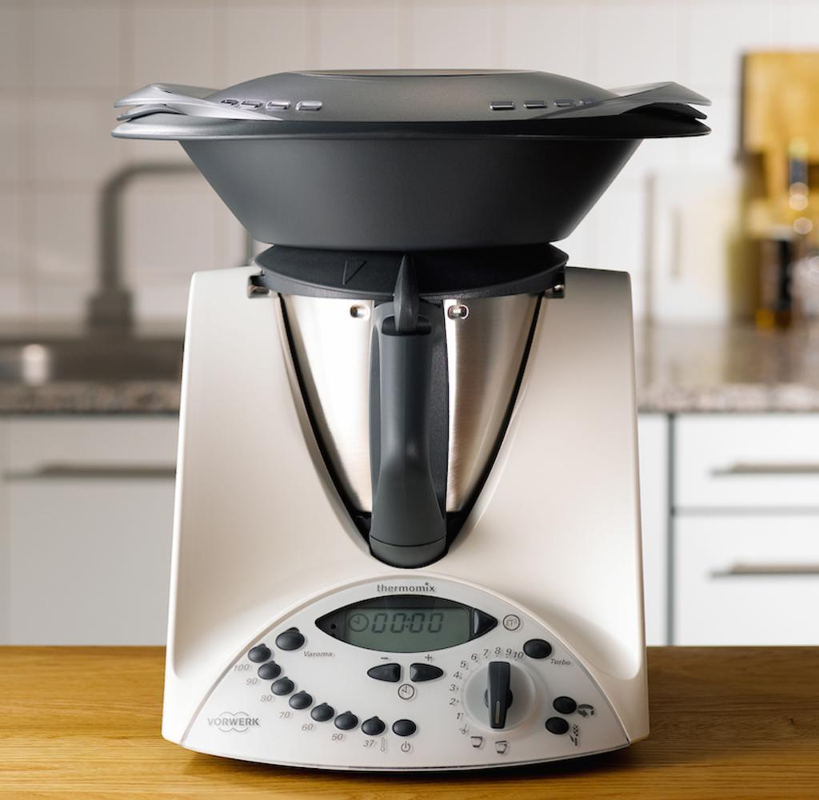
2. Case studies – kitchen aid
Vorwerk Thermomix 31:
sales are dropping;
explanation:
main features not protected;
patents ineffective;
counterfeit products rise
loss in exclusiveness
loss in customer loyalty
VKK Patentanwälte 2019

Slide 25
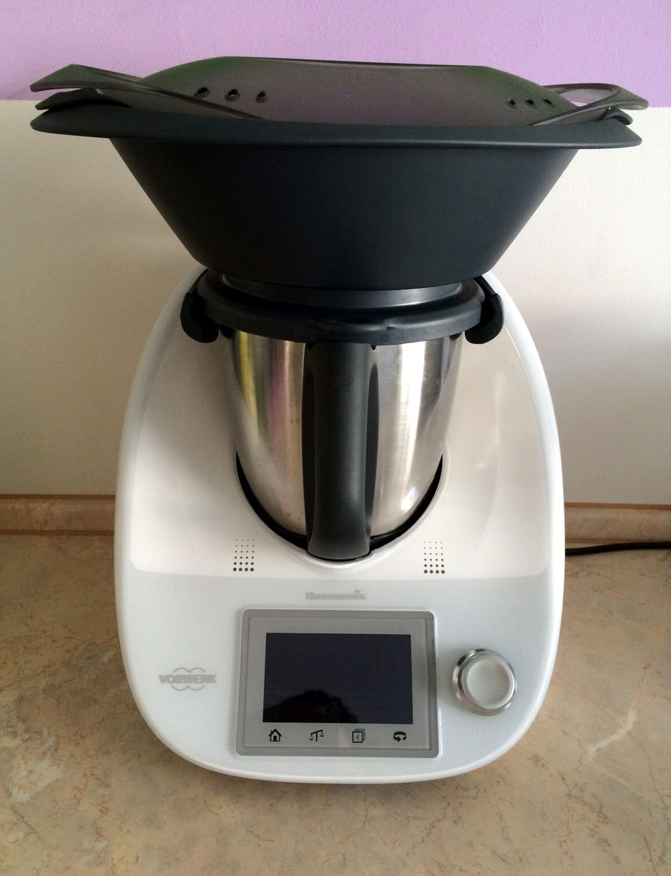
2. Case studies – kitchen aid
Vorwerk Thermomix 51:
cooperation between:
R&D, Marketing, CEO
features decisive for purchase
must be defended
IP-strategy follows marketing strategy
VKK Patentanwälte 2019

Slide 26
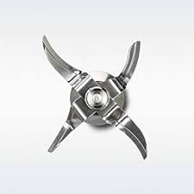
2. Case studies – kitchen aid
Vorwerk Thermomix 51:
patents for the customer benefit
as recognized by customer:
151 Patents (10x > TM3)
various trademarks
various designs
focus: rotating knives
VKK Patentanwälte 2019

Slide 27
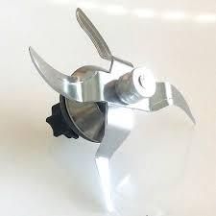
2. Case studies – kitchen aid
Vorwerk Thermomix 51:
decisive features:
fast, creative, healthy, economic, simple
powerful:
The rotating knives!
VKK Patentanwälte 2019

Slide 28
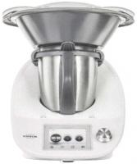
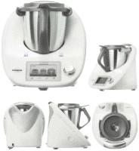
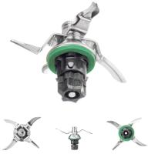
2. Case studies – kitchen aid
Vorwerk Thermomix 51:
Trademarks:
30 2014 059 962
30 2014 059 961
30 2014 061 408
VKK Patentanwälte 2019

Slide 29
2. Case studies – kitchen aid
Vorwerk Thermomix 51:
Trademarks:
UM 003 772 341
UM 008 121 428
UM 015 726 011
VKK Patentanwälte 2019

Slide 30
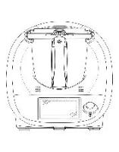
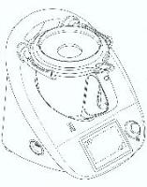
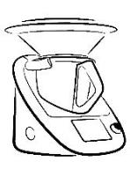
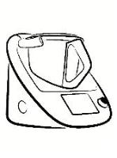
2. Case studies – kitchen aid
Vorwerk Thermomix 51:
Designs:
rCD 001 379 580
rCD 001 420 111
VKK Patentanwälte 2019

Slide 31
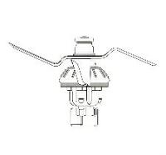
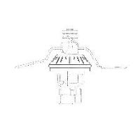
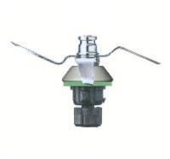
2. Case studies – kitchen aid
Vorwerk Thermomix 51:
Designs:
rCD 001 420 202
rCD 002 529 073
VKK Patentanwälte 2019

Slide 32
2. Case studies – kitchen aid
Vorwerk Thermomix 51:
Patents :
VKK Patentanwälte 2019

Slide 33
2. Case studies – kitchen aid
Vorwerk Thermomix 51:
Patents :
VKK Patentanwälte 2019

Slide 34
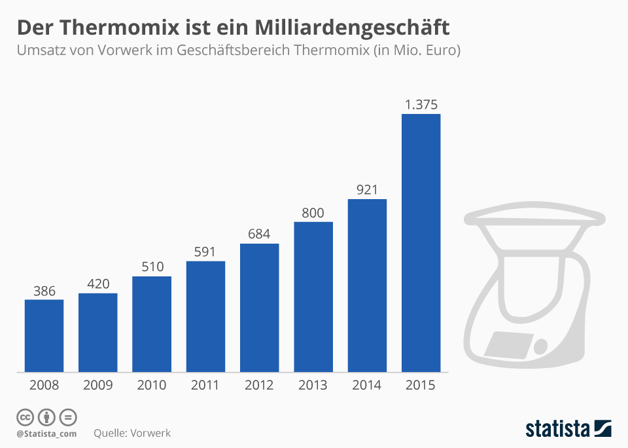
2. Case studies – kitchen aid
VKK Patentanwälte 2019

Slide 35
3. Summary
Strategic IP-rights:
cooperation between R&D, marketing, management
focus on customer benefit as perceived by customer where possible
impeding of takeover of those features, paramount for purchase decision
VKK Patentanwälte 2019

Slide 36
3. Summary
Strategic IP-rights:
marketing
idea
product
protection
Factual protection: strong trademarks, strong sales channels;
+
Juristic protection: Patents, trademarks, designs
VKK Patentanwälte 2019

Slide 38
Thank you!
VKK Patentanwälte PartG mbB
Hamburg Kempten Munich Frankfurt www.vkkpatent.com
VKK Patentanwälte 2019

