Slide 1
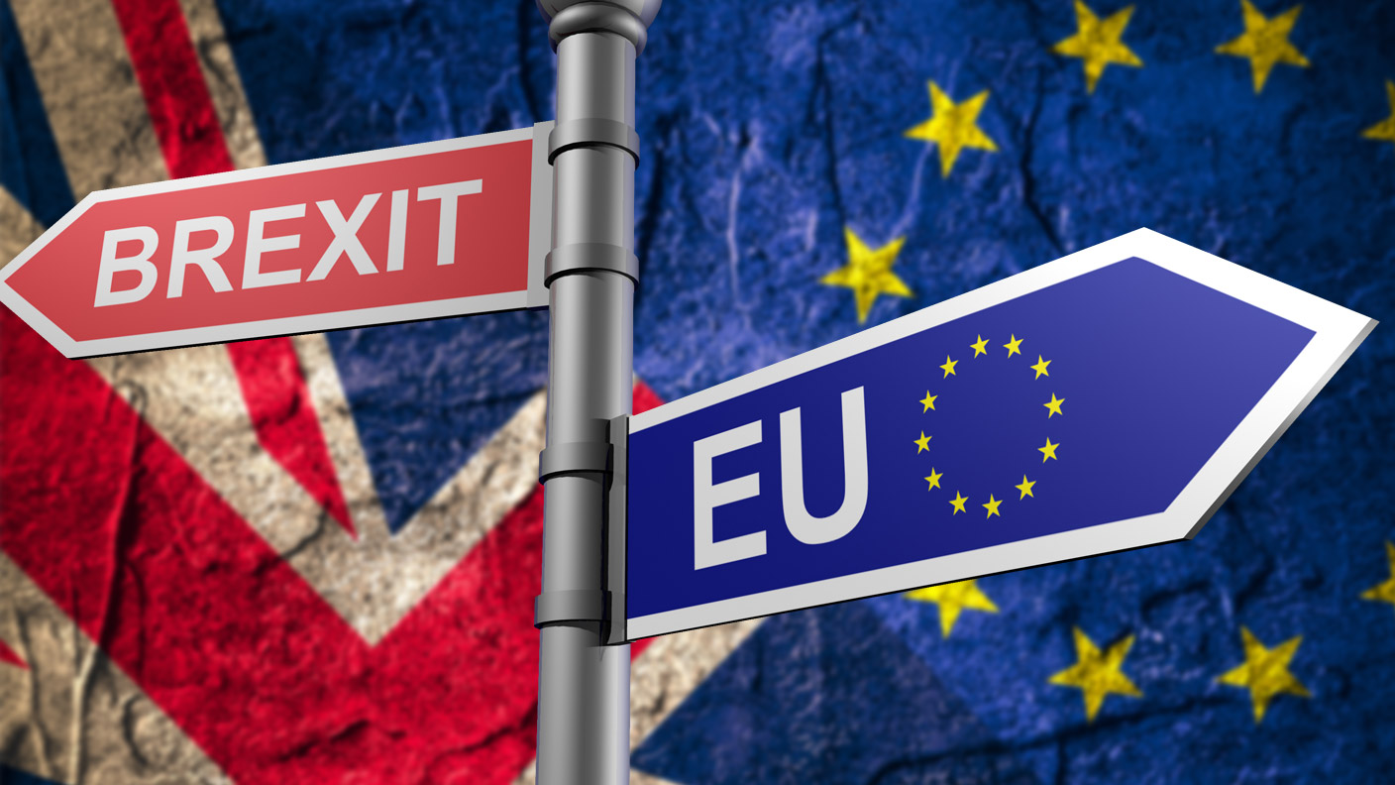
BREXIT What is going to happen to our IP? MARKPATENT SEMINAR February 2019 Alberto Giordano EU TRADEMARK AND DESIGN ATTORNEY

Slide 2
Brexit: the actual scenario
Brexit is the June 23, 2016, referendum where the United Kingdom voted to leave the European Union. Brexit is the nickname for "British exit" from the EU.
On March 29, 2017, the UK Prime Minister Theresa May submitted the Article 50 withdrawal notification to the EU.
It gave the U.K. and EU until March 29, 2019, to negotiate an agreement.
The Prime Minister and the EU agreed to a 21-month transition plan on March 19, 2018. But on January 15, 2019, UK Parliament voted against the plan.
On January 21, 2019, UK Government submitted to Parliament a revised transition plan. It includes a "backstop" that keeps the U.K. in a customs union with the EU if they can't reach a solution on the Ireland issue. Another referendum is not an option.
In the meantime the U.K. signed a bilateral trade agreement with Switzerland to avoid tariffs in case of a "no deal Brexit."
On February 7, 2019 the EU said it won't agree to any changes to the existing plan, but behind-the-scenes talks are ongoing……

Slide 3
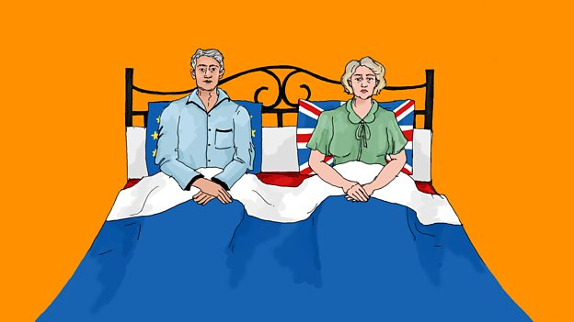
Brexit: the actual scenario
but behind-the-scenes talks are ongoing……

Slide 4
The withdrawal agreement
Brexit Plan Summary
The agreement between UK and EU that must be approved by UK Parliament has two parts. One is the binding withdrawal agreement. The other is a non-binding set of principles to guide future negotiations.
Transition
The transition period (which the UK government calls "implementation period“) begins on 29 March 2019 and lasts until 31 December 2020.
The draft withdrawal agreement says the transition can be extended, but only for a period of one or two years (in other words up to the end of 2022 at most).
Both the UK and EU must agree to any extension and the decision must be taken before 1 July 2020.
Under the plan, the UK remains within a "customs union" with the EU for an unspecified period.
The UK retains complete access to capital. The 3 million European nationals living in the U.K. can continue to live and work in the country without work visas. The 1.3 million U.K. citizens can continue to do the same in the EU.
The U.K. would also abide by the European Court of Judgment and EU laws.
But, since it's no longer a member of the EU, the UK can no longer vote on the laws. That is similar to Norway's relationship with the EU.

Slide 5
The withdrawal agreement
The Northern Ireland issue
Since the U.K. remains in the EU customs union, it prevents a "hard border" between northern and southern Ireland. Northern Ireland is part of the U.K. and southern Ireland is an independent country and a member of the EU.
Until 1998, this was a militarized border due to sectarian violence that left more than 3,500 people dead. But once the transitional period is over, this issue must again be confronted.
The “divorse bill” to pay
The U.K. will pay a 50.7 billion euro "divorce bill." It fulfills any remaining financial commitments.
The deal would keep the U.K. in the single market for trade while allowing it to restrict immigrants.
In return, the U.K. must abide by all EU environmental, social, and customs rule. The deal is what the British dependency of Jersey already has. It would avoid borders between Northern Ireland and the U.K. or Ireland.
If the deal had been approved by Parliament, then the U.K. and EU would draft a detailed trade declaration.
Any plan must then be approved by the European Council, the 20 EU countries with 65 percent of the population, and the European and U.K. Parliaments.
Once those major hurdles were overcome, then the U.K. would copy the EU laws into its laws, which can later be amended or repealed.

Slide 6
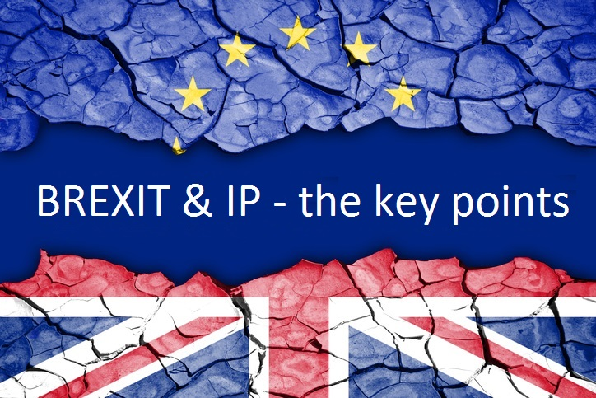

Slide 7
IPR in the Withdrawal Agreement
UK IPO will continue to protect all existing registered EUTM, RCD and Unregistered Community Designs as UK leave the EU.
UK IPO will create over 1.7 million comparable UK rights, which will be granted automatically and free-of-charge.
Accordingly to UK IPO, the UK government has been clear that the Withdrawal Act and any further secondary legislation made under the Act will not aim to make major changes to policy or legislation beyond those which are necessary to ensure the law continues to work properly on day one.

Slide 8
IPR in the White Paper
The UK government published a White Paper on the Future Relationship between the UK and the EU, setting out an important vision for elements of the future relationship between the UK and EU on intellectual property.
In particular, the White Paper proposes that the UK should continue to participate in the unitary patent system and the Unified Patent Court that underpins it.

Slide 9
Reppresentative
Rights of representation
UK practitioners who are representing clients before the CJEU and EUIPO in cases that are pending at the end of the implementation period will be able to continue acting in those cases until their conclusion.
In the White Paper, the UK government will be seeking to establish a joint practice arrangement whereby UK and EU legal representatives will be able to jointly support clients with cases before EU institutions, including before the EUIPO and the CJEU.

Slide 10
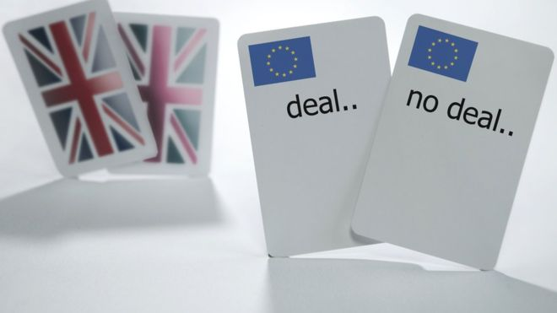
The «no deal» scenario
In the event of a ‘no deal’ scenario,
the UK government has published draft
regulations related to all the EU right and
technical notices on intellectual property were published on 24 September 2018:
• trade marks and designs if there’s no Brexit deal
• patents if there’s no Brexit deal
• copyright if there’s no Brexit deal
• exhaustion of intellectual property rights if there’s no Brexit deal

Slide 11
The «no deal» scenario: TM and design
Trade marks
UK system: largely unaffected by the UK’s decision to leave the EU.
While the UK remains a member of the EU then EUTM continue to be valid in the UK.
When the UK leaves the EU, in any scenario, an EUTM will continue to be valid in the remaining EU Member States and UK businesses will still be able to register an EU trade mark, which will cover all remaining EU Member States.
UK government will seek to minimise disruption for business and to provide for a smooth transition:
For existing EU trade marks, this means that for all scenarios, the government aims to ensure continuity of protection and avoid the loss of those rights.
In addition, the UK is a member of the international trade mark system called the Madrid System and this will not change.
Continued protection of registered trade marks and designs in the UK
Before 29 March 2019
EU trade marks registration and Registered Community designs registered before 29 March 2019 provides protections across all EU member states including the UK but only if they get registered.
International Madrid registration and the International Design registered before 29 March 2019 are also protected in the UK.

Slide 12
The «no deal» scenario: TM and design
After March 2019 if there’s no deal
The UK government will ensure that the property rights in all existing registered EU trade marks and registered Community designs will continue to be protected and to be enforceable in the UK by providing an equivalent trade mark or design registered in the UK.
Opt-out option
Right holders with an existing EU rights will have a new UK equivalent right granted that will come into force at the point of the UK’s exit from the EU.
The new UK right will be provided with minimal administrative burden. The trade mark or design will then be treated as if it had been applied for and registered under UK law and so:
will be subject to renewal in the UK
can form the basis for proceedings before the UK Courts and the IPO Tribunal
can be assigned and licensed independently from the EU right
The IP owner may on notice “opt out” from having a new correspondent right in UK.
Pending application
Will not be automatically converted into a UK IP rights but the IP owner may within nine months of Brexit day apply for registration of the same IPR maintaining the priority of the correspondence EU right.

Slide 13
The «no deal» scenario: TM and design
What action should be taken?
Nothing to do, unless the IP owner wish to opt-out.
What to take in consideration?
Use of the trademark: if the trademark is used only in UK or only in the 27 EU country, this will effect the UK or EU registration. EUIPO will recognize the use in UK until the Brexit day.
Renewal: it is advisable to renew the IPR expiring before the Brexit day to ensure continued protection in UK.
If the renewal date is after the Brexit day, it will be necessary to renew the EU right and the correspondent UK right separately.
Assignment and license: it is advisable to review any assignment and license contract and file the recordal at EUIPO before the Brexit day.

Slide 14
The «no deal» scenario: TM and design
Pending proceedings: No information available yet for UK proceeding involving EU right.
The EUIPO has indicated that pending proceedings based only on UK right will be rejected after Brexit.
It is advisable for the new UKIPO oppositions and invalidation application should be based on UK rights;
and for new EUIPO opposition and invalidation should be based not only on a UK right.
Infringement proceedings: after Brexit, UK Court will no longer be competent to act as EU TM and CD Court and the 27 EU member states wil no longer be competent to grant injuctions which apply to uk.
It is advisable to consider any ongoing proceeding and value if it will be necessary to start separate proceeding accordingly.
Representation: UK will reconize the existing EU rappresentatives before the UKIPO for the corresponding UK registered right.
UK practicioner are unlikely to be able to continue to act as reppresentaative before EUIPO.

Slide 15
The «no deal» scenario: unregistered design
While the UK remains a member of the EU, designs, two- and three-dimensional designs (including, for example, clothing designs and patterns) can be automatically protected in the EU as ‘unregistered Community designs’. This gives a design 3 years protection from copying.
Once the UK leaves the EU, unregistered protection for designs will continue to exist through the UK unregistered design right.

Slide 16
The «no deal» scenario: patent
European patents
The Brexit will will not affect the current European patent system, which is governed by the (non-EU) European Patent Convention.
Supplementary Protection Certificates
While the UK remains a full member of the EU, businesses can continue to apply for and be granted Supplementary Protection Certificates (SPCs) for patented pharmaceutical and plant protection products using the current SPC system. Existing UK SPCs granted under that system continue to be valid.
Once the UK leaves the EU, UK businesses will still be able to apply for SPCs in all remaining EU Member States under the existing system.
As far as the UK’s own SPC regime is concerned, our intention is to provide maximum certainty and clarity for businesses operating in this important area of innovation. We will do this by maintaining the current SPC legal framework in the UK as we leave the EU.
Unified Patent Court
The UK ratified the Unified Patent Court Agreement (UPCA) on 26 April 2018.
The UK intends to stay in the Unified Patent Court and unitary patent system after we leave the EU.
The Agreement on the Unified Patent Court (UPC) is an international treaty. The international court will have jurisdiction over patent disputes across its contracting states.

Slide 17
The «no deal» scenario: Unitary Patent
If Germany will ratify the UPC agreement and UPC comes into force, it is not certain that UK will remain within the UPC and Unitary patent system.
If the Unified Patent Court comes into force and the UK is unable to participate:
UK, EU and third country businesses will still be able to use the Unified Patent Court and unitary patent to protect their inventions within the EU
UK, EU and third country businesses seeking protection in the UK for their inventions will need to use national patents and the UK court system

Slide 18
The «no deal» scenario: exhaustion
Exhaustion of IP rights
While the UK remains a full member of the EU, IPR remain exhausted after the first sale of a good, with the right holders permission, within the territory of the European Economic Area (EEA).
After Brexit with no deal, UK will unilaterally maintain in force the current EEA regional exhaustion regime from exit day to provide continuity in the immediate term for businesses and consumers.
Intellectual property-protected goods placed on the EEA market by, or with the consent of, the right holder after the UK has exited the EU will continue to be considered exhausted in the UK.
This means that parallel imports of these goods from the EEA to the UK will be able to continue unaffected.
Goods placed on the UK market by or with the consent of the right holder after the UK has exited the EU will not however be considered exhausted in the EEA.
This means that businesses exporting these goods from the UK to the EEA might need the right holder’s consent.

Slide 19
Domain names: .eu
Only residents of the UE can currently register an .eu domain name.
And the entities that are established only in the UK will no longer be eligible to register .eu domain names or to renew .eu DN already registered.
In case of no deal, there will be the following conseguences:
UK registrants of .eu DN will have until May 30, 2019 to update their contact details to an EU address
Who will fail to do so, as of May 30, 2019 all registrant that do not demonstrate their eligibility will be deemed ineligible and their DN will be withdrawn but they will remain in the .eu registry and may be reactivated if the eligibility criteria are satisfied.
Registrants has time until March 30, 2020 to transfer their contact detail to eu. After this date, all the afcted domain names will be revoked and will become available for general registrations.

Slide 20
THANK YOU FOR THE ATTENTION READY FOR QUESTION….. AND IF YOU NEED FURTHER INFORMATION: FRANCOMARTEGANI@FRANCOMARTEGANI.IT A.GIORDANO@FRANCOMARTEGANI.IT

