Slide 1

THE SPECIFICS OF PROTECTION OF
THE INTELLECTUAL PROPERTY RIGHTS
IN RUSSIA AND EURASIAN COMMUNITY
by Evgeny Kolesov,
Associate, Vash Patent LLC, Moscow, Russia

Slide 2
SUCCESSFUL BUSINESS STRATEGY
Knowing how to protect and enforce
your Intellectual property rights
Understanding of specifics of
a given jurisdiction

Slide 3
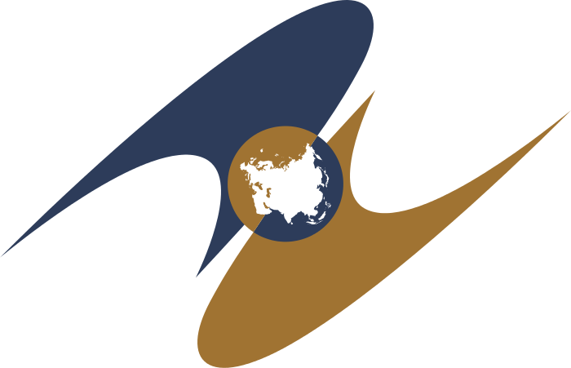
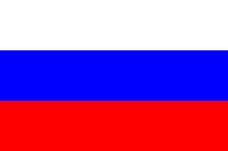
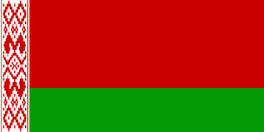

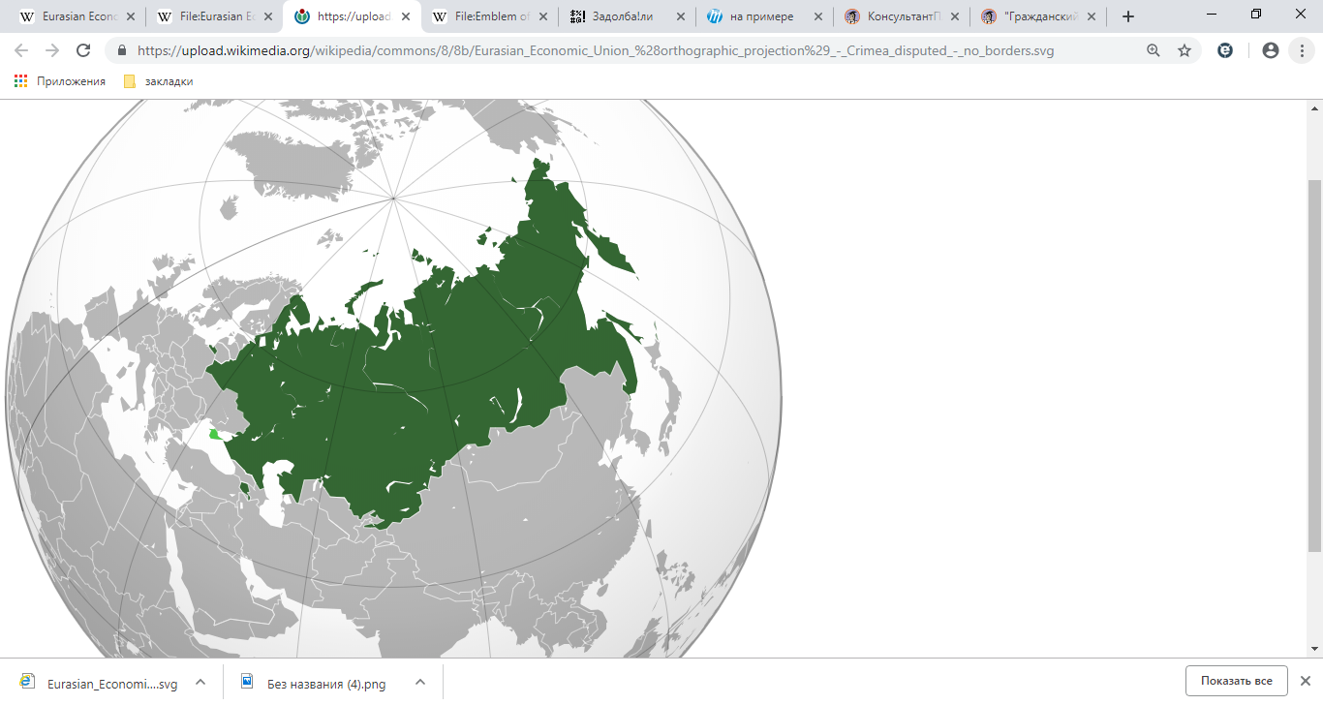
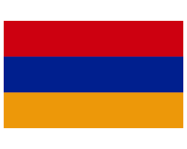
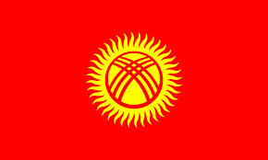
EURASIAN ECONOMIC UNION
(former Eurasian Community)
Member states:
Russia
Belarus
Emblem of the Eurasian Economic Union
Kazakhstan
Armenia
Kyrgyzstan
Map of the Eurasian Economic Union

Slide 4
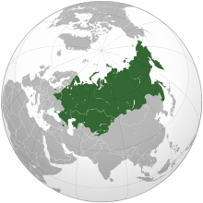

TRADEMARKS
(Russia and the Eurasian Customs Union)
PROSECUTION:
TM application is being examined by the Office on absolute and relative grounds;
No opposition period;
Duration of procedure – 10-12 months (could be sped-up to 3-4 months)
USE REQUIREMENT:
TM holder is required to start using his trademark within three years from the date of registration (otherwise the TM is subject to cancellation due to non-use if third parties prove their interest to use the TM);
MADRID SYSTEM:
Russia and other Eurasian Economic Union states (Belarus, Kazakhstan, Armenia, Kyrgyzstan) are members of the Madrid System of the International trademark registration.
REGIONAL PRINCIPLE OF THE EXHAUSTION OF THE TM RIGHTS:
Using a TM in relation to products that were legally imported into the Eurasian Customs Union does not infringe the TM rights.
New
New
Eurasian Customs Union
Russia
Belarus
Kazakhstan
Armenia
Kyrgyzstan

Slide 5
PATENTS
(Russia)
INVENTION PATENT
is granted for a technical solution, related to a product (device, substance, microorganism strain or cell culture) or a method (a process of manipulating over a material object with material means). that is new, having an inventive step and industrially applicable
UTILITY MODEL PATENT
is granted for a technical solution, related to a device that is new and industrially applicable.
+
a) less time to obtain an utility model patent compared to invention patent
b) does not require an inventory step (thus more easily to obtain).
-
a) lower period of validity compared to an Invention patent (15 years VS 25 years)
b) limited scope of protection (only device)
PCT
Russia and other Eurasian Economic Union states are members of the PCT system. The Russian Patent Office (Rospatent) is:
receiving office,
international search authority
preliminary examination authority.

Slide 6


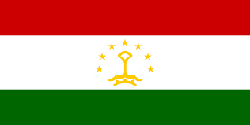

Eurasian Patent System
Eurasian Patent Organization (EAPO)
Single invention patent for 8 Eurasian countries (Russia, Belarus, Armenia, Azerbaijan, Kyrgyzstan, Kazakhstan, Tajikistan and Turkmenistan) saving on costs and time for patent prosecution in eight different Eurasian countries.
Russia
Belarus
Armenia
Azerbaijan
Kyrgyzstan
Kazakhstan
Tajikistan
Turkmenistan
1 Eurasian
Patent*
Eurasian patent protects only inventions (thus
Utility models and designs are not covered
by the Eurasian patent system)

Slide 7
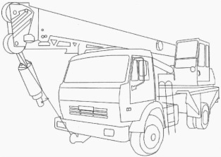

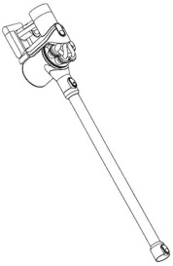
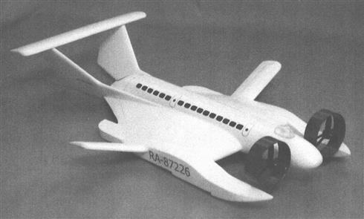
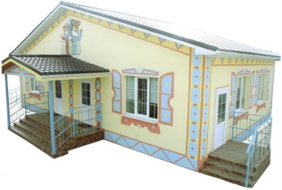
INDUSTRIAL DESIGNS
(Russia)
INDUSTRIAL DESIGN PATENT
is granted for a solution related to an artistic and design presentation of an article, an outward appearance of a product.
Period of validity – 5 years, can be renewed for another five years multiple times (maximum duration 25 years);
Wider scope of protection – the industrial design patent protection covers not only the features claimed in the patent, but also the designs, which features are similar to those in the patent and making the same common visual impression.
An Industrial design patent may relate to:
packing;
electronic devices;
trade pavilions;
automobile drilling platforms;
even whole buildings;
and other things...
HAGUE SYSTEM
Russia is a party to the Hague Agreement for the registration of the industrial designs (from February, 2018).
New
New

Slide 8
COPYRIGHT
(Russia)
A copyright protects:
literature works
This works may be deposed with the Russian authors’ society that certifies the copyright as of the date of
deposition of the copyrighted work
dramatical pieces
musical works
films and other audiovisual works
software
May be registered and deposed with the Russian Patent Office (Rospatent) that issues a Software or
a Database Registration Certificate
database
other creative works.
No registration or other formalities are required in order to obtain protection for copyrighted work.
(however deposition/registration certificates may serve as proof of copyright that are recognized by courts and law enforcement
authorities)
Foreign copyrighted works are protected under the Berne convention (and other bi- and multilateral agreements).

Slide 9
liabilities for the infringement of the IPR (Russia)
Administrative liability
(fine, forfeiture and destruction of counterfeit goods/media)
Criminal liability
(fine, imprisonment, forfeiture and destruction of counterfeit goods/media)
Civil liability
recovery of damages
forfeiture and destruction of counterfeit goods/media
compensation to the IPR holder(s)
Up to 5 million Rubles (~77000 USD) or 2x costs of counterfeit goods

Slide 10
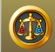
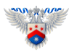
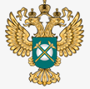

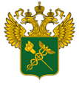
The IPR are enforced by
Courts
Customs
Law enforcement agencies (Police)
Federal Antimonopoly Service
Court for the Intellectual Rights
appeal court for all cases involving the IPR infringement;
first instance court for cases involving contesting of the decisions of the Federal service for intellectual property (Rospatent)
Chamber for the patent disputes of the Federal service for intellectual property:
post-grant and administrative proceedings in relation to prosecution of the industrial property rights
appeals against the final decisions of the Office.
Federal Antimonopoly Service.
IPR infringements involving unfair competition or abuse of rights;
contestation of a TM on basis of an unfair competition;
Customs
enforcement of IPR in relation to import and export of goods crossing the border of the Eurasian Customs Union.
tracing goods bearing or reproducing an IP objects included in the Customs Registry of the IP Objects (trademarks, registered appellations of origin, copyrighted works).
.

Slide 11
THANK YOU
FOR
YOUR ATTENTION!

